Slide 1
Database
Management System
Lecture - 32

Slide 2
Application Programs

Slide 3
Application Programs
Programs written to perform different requirement posed by the users/organization
The concern of the developer
Performed in parallel or after DBD
Tool selection is critical BUT

Slide 4
General Activities
Data input programmes
Editing
Display
Processing related to activities
Reports

Slide 5
User Interface
Almost all activities through UI
A gateway to DB world for end users
Main concern of users in an application; crucial

Slide 6
User Interfaces
Text based
Graphical User Interface (GUI)
(Most Common, generally called Forms)

Slide 7
Text Based UI
Adding a Record --------- 1
Deleting a Record --------- 2
Enrollment --------- 3
Result Calculation --------- 4
Exit --------- 5

Slide 8
Forms
Browser based
  HTML, scripting languages, Front Page
Non-Browser/Simple
  Visual Basic, Developer, MS Access
Form tools support simple built-in functionality

Slide 9
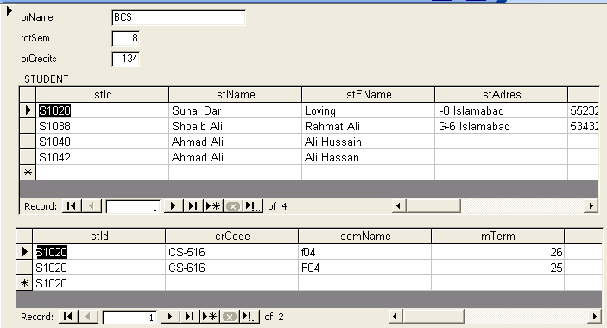
Graphical User Interface

Slide 10
User Friendly Interface
Beginners (What and How)
Intermediate (What)
Experts (Both)

Slide 11
Tips
User friendly
Make users in charge
Don’t test users’ memory
Be consistent

Slide 12
Tips
Should be processes based rather than the data structure based
Document structure (single page vs multiple pages)

Slide 13
Entities and Relationships
Simple entity on a page
Hierarchies of entities

Slide 14
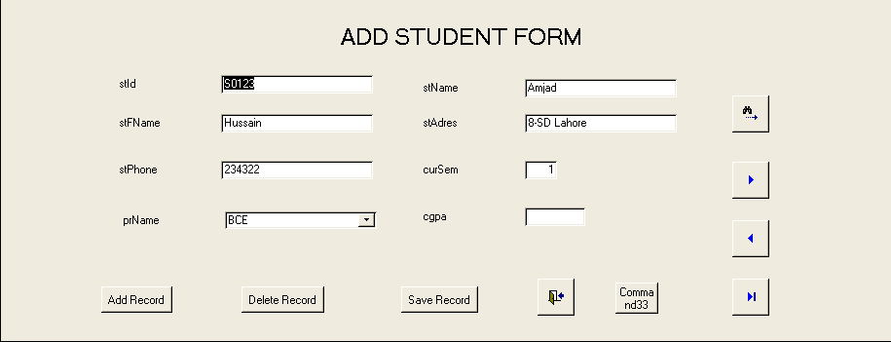
Simple Entity

Slide 15
Hierarchies of Entities

Slide 16
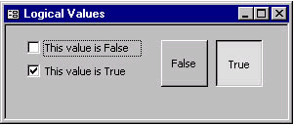
Windows Controls
So many of them
Logical values

Slide 17
Windows Controls
So many of them
Logical values
Set of values

Slide 18
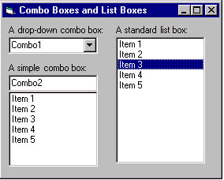
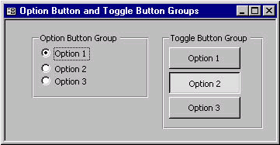
Windows Controls

Slide 19
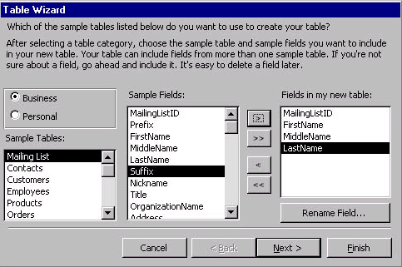
Set of Values

Slide 20
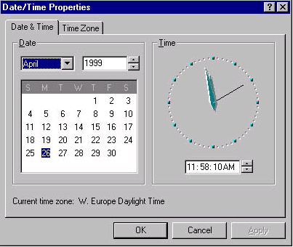
Numbers, Dates and Text
Normally text boxes

Slide 21
Maintaining Data Integrity
Basic rules
Business rules

Slide 22
Database
Management System
Lecture - 32

